Slide 1

The King's Awards for Enterprise

Slide 2


Create an award submission that stands out

Slide 3
Agenda
Introductions
Award cycle
Eligibility criteria
Crafting a strong application
Top tips for each category
Advice from a local winner, Camps des Reves!

Slide 4
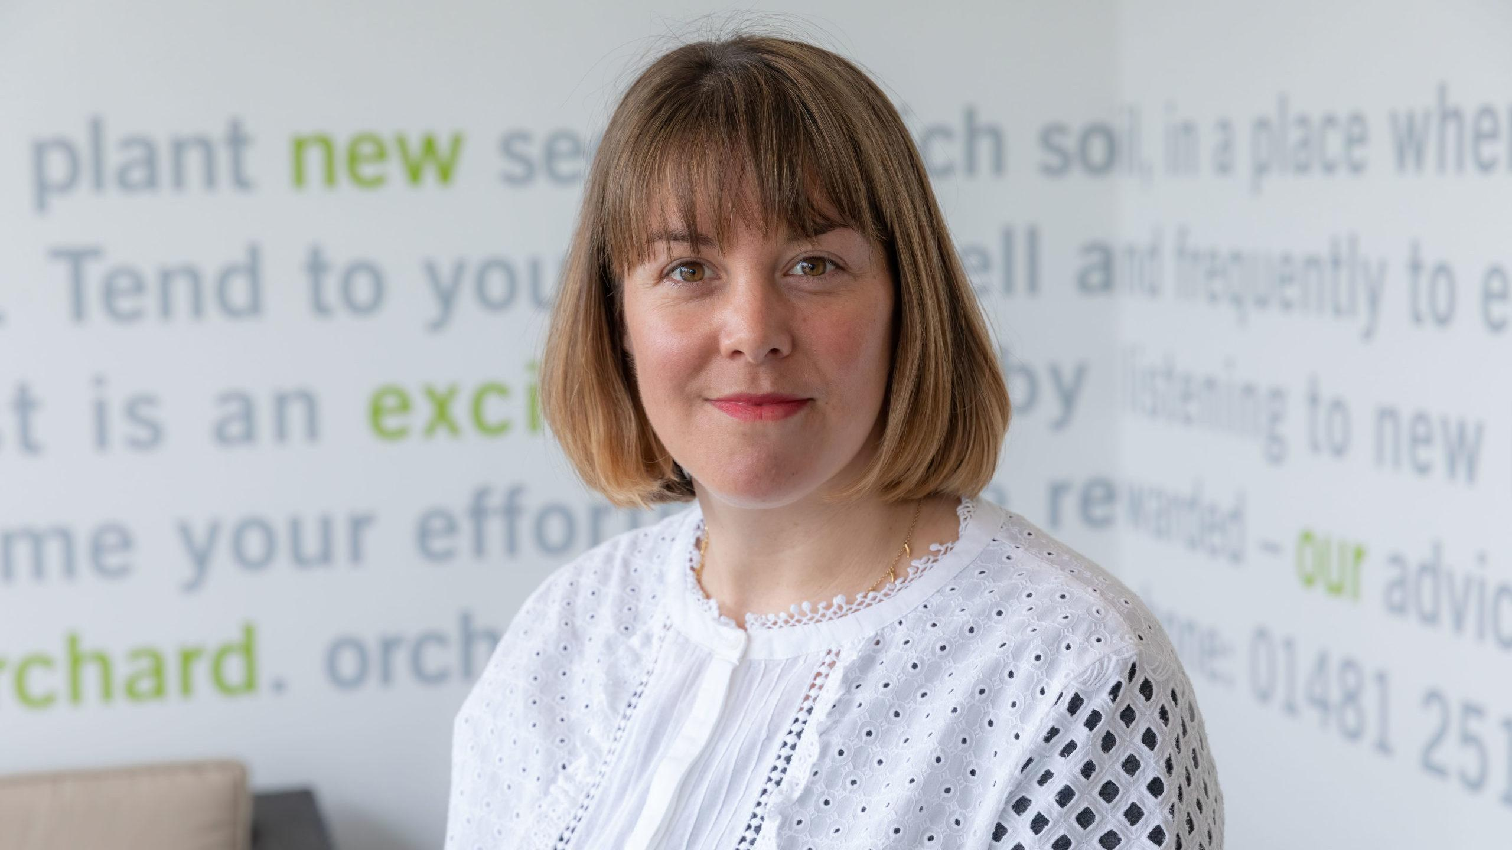
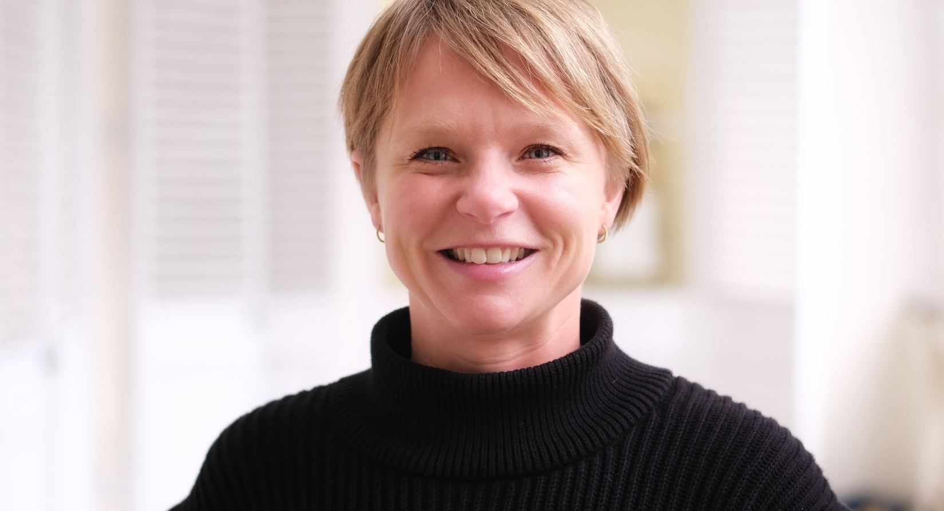
Introductions
Brooke Kenyon
Managing Director
Orchard
Alice Gill
Exec Director
Chamber of Commerce

Slide 5
ABOUT US
GET TO KNOW US BETTER
Connect - We connect you with like-minded businesses and supporters via our vibrant events programme, and thoughtfully made introductions.
Promote - We help boost your visibility through event sponsorship, content sharing, social media exposure, newsletters, and magazine features.
Support - We advocate & campaign on the issues that matter to our members, and provide affordable training to upskill their teams.
Guernsey Chamber is the island’s largest business community, dedicated to helping local businesses thrive. We connect people, promote brands, and deliver training that makes a difference, while advocating for the issues that matter most. Collaboration and collective action are at the heart of what we do, driving growth, opportunity, and a stronger future for Guernsey’s business community.
500 members, representing 10,000 employees. 83% of members are SMEs
, President of Chamber
Notes:
I’ll begin with a quick word about the Guernsey Chamber of Commerce. We are the island’s largest business network, representing over 500 organisations and 10,000 employees — 83% of which are small and medium-sized businesses. Our mission is simple: to help local businesses thrive. We do that by connecting people, promoting our members’ work, and advocating for the issues that matter most to the business community.
At the heart of all we do is a belief in collaboration, innovation, and creating the right environment for businesses to grow. That’s why we’re so pleased to support and promote the King’s Awards for Enterprise — because they align so well with those values.

Slide 6
About the Kings Award for Enterprise
Recognising and encouraging the outstanding achievements of UK businesses in the fields of:
        Innovation
        International Trade
        Sustainable Development
        Promoting Opportunity (through social mobility)
The UK is full of exciting and innovative businesses and The King’s Awards for Enterprise is a great way of celebrating their success.
Whether a small business with a great innovative product or service, or a larger company running an impressive social mobility programme, this award is a prestigious way to recognise your contribution to enterprise.
Notes:
The King’s Awards for Enterprise are the UK’s most prestigious business awards — a globally recognised royal seal of approval
They were established in 1965, as The Queen’s Award to Industry and since then, more than 8,000 businesses have been honoured. Today, His Majesty King Charles continues that tradition, and the awards now bear his name — reflecting his commitment to celebrating innovation, sustainability, and enterprise across the UK.
There are four award categories, and you can apply for more than one:
Innovation, recognising commercially successful, original products and services.
International Trade, for exceptional growth in overseas earnings.
Sustainable Development, for organisations that embed sustainability into their strategy and operations.
And Promoting Opportunity, which recognises businesses helping people from disadvantaged backgrounds to gain skills and meaningful work.
In 2025, 88% of award recipients were SMEs, and 14% were micro-businesses — so don’t let size be a barrier. These awards are accessible, and Guernsey businesses absolutely have what it takes to win.

Slide 7
Eligibility Criteria
The organisation must:
Be based in the UK including the Channel Islands and Isle of Man
Have a good, continuous compliance record with HM Revenue and Customs or the relevant tax authority
Be a self-contained enterprise
Have at least two full-time employees or part-time equivalents
Demonstrate strong environmental, social and governance (ESG) practices

Slide 8
How to apply
Almost all businesses (including non-profit) can apply
The application process is free
All applications must be made online
You may apply for more than one category
Applications for the 2026 King’s Awards for Enterprise open on 6 May until 1pm 9 September 2025

Slide 9
Awards Cycle
Open for new round of applications
(6 May)
Assessment of Entries
(Sept-Oct)
Due Diligence checks
(Nov)
4 Judging Panels
(Jan-Feb)
Awards approved – PMAC, No.10 and HMK (March)
Awards Announced
(6 May)
Application process closes
(9 Sept)

Slide 10
Assessment process
Multiple stages of rigorous moderation. Each application is assessed independently by two assessors
Moderators check any anomalies
The experience of the assessment team is highly diverse
After shortlisting, due diligence checks are carried out by other government organisations (HMRC, HSE, DWP etc)
Assessors can ask companies for clarification
Assessors evaluate the quality of programme, extent that it is embedded and its impact – eg on the market (innovation) on the people it has helped (for promoting opportunity)
Assessors can review published information about applicants like websites and Companies House information but cannot contact the company direct.
Assessors look for reasons to ‘recommend’ or ‘reserve’ applications for the judging panel in January
Notes:
This is an overview of the assessment process
Assessment starts in September from the submission deadline (12 September 1pm)
Shortlisting is confirmed 6 weeks after the submission date – so c24 October so that the independent assessment team has time to sift thoroughly
just after shortlist is agreed, shortlisted applicants are informed by email and are asked to provide verified figures (for Innovation and International Trade)
[Nicky can we add:] this is the only part of the application process that will involve fees for the applicant - we are asking shortlisted applicants to provide figures verified by an external accountant.
Shortlisted applications undergo due diligence checks with government bodies
Unsuccessful applicants are informed with feedback by March

Slide 11
Creating a Strong Application

Slide 12
Application Guidance
Have a good social media presence, it is very likely to be looked at by assessors
Plan your responses by downloading the pdf application form
Use plain English – the assessors are coming to your initiative from scratch
Provide evidence of your achievements, qualitative and quantitative.
Don’t waffle.
Tell your own story with authenticity and passion – why do you stand out
Add 2 or more collaborators to your account – spread the work
Allow sufficient time – you’ll need to gather evidence, ask your accountant etc
Be specific. Answer it once, answer it well – you can refer back to previous answers
Notes:
Here are some of the top tips to share with applicants once they have passed through the eligibility questions and have started their application:
Firstly, register on the application system. This will allow you to download a PDF and Word version of the application form.
Add collaborators to your application account. This will allow others such as the business owner, and colleagues to be able to help and contribute to your application, as well as ensuring that someone else will have access to the form in your absence.
You can then plan your application and share the form with others.
Preparation - read through the whole form before starting to fill it in.
Use plain English. Successful applications manage to avoid technical jargon. The application must be easy to read and understand to assessors, even if they are not necessarily experts in the sector.
Provide evidence. Please provide qualitative and quantitative evidence to support all your statements.
Tell your story in your own words; we want to hear about your personal journey; why did you start the business and the key drivers for you in making your business successful.
Allow sufficient time. Do make sure that you plan your application properly, to allow enough time to complete it.

Slide 13
Tips for a strong application – Innovation
Notes:
In the Innovation category, they are looking for unique products or services that have been successfully commercialised for at least two years. Applicants must clearly explain what the innovation is, how it was developed, and the challenges overcome. Avoid marketing fluff - they want facts, not slogans. Think substance over style: what changed because of your innovation, and how has it benefited your business and customers?

Slide 14
Application Guidance:
Innovation
To apply for the Innovation Award, you must:
have an innovation that has not been sold before
have had your innovation available on the market for at least 2 years
have recovered all the investments made in your innovation or show that the innovation will recover its full costs in future
Show outstanding commercial success as a result of innovation from 2 up to 5 years
Your innovation should be in one of the following categories:
invention, design or production of goods
performance of services
marketing and distribution
after-sale support of goods or services
Your story:
What was the situation which led to your innovation?
What are the challenges you have overcome
Why is your innovation unique
How does your innovation benefit your business, customers and others
Applicants must now submit their most recent commercial success and not wind back to the pre-covid years
Notes:
In the Innovation category we want to hear why your innovation is unique and how it has benefited your business, customers and others.
The key thing to note is that it needs to have been on the market for 2 years.
There are some key things that people miss out of their application: for example, some forget to tell the assessors what their innovation is!
Applicants need to describe:
What the innovation is, how it was developed it, what challenges you faced, who you worked with to develop it, why things are better because of it.
Present it clearly and in a descriptive way with a reasonable level of technical details. The assessors are all highly qualified and experienced people who can understand technology and science. BUT Avoid going over the top with jargon and acronyms.
Marketing language that you would find in a brochure is not acceptable – there’s an old sales expression “Sell the sizzle, not the steak”: however, the assessors want to hear about the steak – ie what the innovation is, what impact it has had, not how great it is.
The questions are in that order for a reason – we’ve tried to put them in an order that helps applicants to tell their story.
We’re also considering the innovation’s non-commercial value that’s added by the innovation – it could be internally to the company, helping develop new skills, acquire new knowledge, open new markets or raising the profile of the business. For the customers that buy the innovation – what are the benefits, does it help them do things faster, cheaper etc. We look for the additional benefits.
We look at evidence when claims are made in terms of benefits delivered. So if the applicant wants to say that, please give evidence that supports. Please give quantifiable data and if that isn’t available, then we’d like testimonials. Evidence that supports the claims being made.
Innovation - the commercial section
The biggest reason applicants fail to be recommended is failure to demonstrate commercial success. We need to see that the innovation that has been developed has had an impact: that sales have increased or market penetration achieved, or has brought lots more customers to the business.
We also need to see that there has been a return on the investment – if someone has invested £1m and had £10k turnover, they are not quite ready for an award yet and would need some evidence of greater. If it’s not obvious in the financial data that’s presented, then it needs to be explained in the narrative. Sometimes it is possible that an innovation has had a significant impact financially, but the top line figures aren’t reflecting this. This could be because one or two previous lines have become obsolete and a new innovation has replaced them and if they hadn’t replaced the previous lines, then the business would have declined significantly.
Do sense check figures when entering them – it doesn’t make sense for the sales of the innovation is greater than the total sales of the company.

Slide 15
Tips for a strong application – Innovation
The Innovation
What is the innovation?
How did you validate the idea?
What did you do to develop it?
What difficulties were overcome?
Why is it better than what went before?
Who are your competitors?
The Value Added
What non-commercial benefits have been delivered?
What are the benefits to customers? (Quantify!)
Are there any wider benefits? E.g. to the environment, society etc.
Commercial Performance
Impact – can the impact of the innovation be seen financially?
ROI – can you demonstrate that the investment has been recovered or is likely to be recovered?
ESG
Does the business act responsibly?
Relevant to the size of business

Slide 16
Tips for a strong application – International Trade
Notes:
For International Trade, you need to show strong growth in overseas earnings — either sustained over six years or steep over three. The baseline is £100,000 in overseas sales in year one, with no dips in the years that follow. We want to hear your story: how did you choose your markets, what strategies worked, and how has trade shaped your business? The assessors look at each company in context, so give them a clear and honest picture of your journey, and don’t be afraid to highlight the challenges as well as the successes.

Slide 17
Application Guidance:
International trade
To apply for the International trade Award, you must:
have made a minimum of £100,000 in overseas sales in the first year of your entry and show year-on-year growth
Your story:
prove that your organisation has achieved outstanding growth in overseas earnings relative to your business size and sector
prove steep year-on-year growth (without dips) in overseas sales over 3 years - or substantial year-on-year growth (without dips) over 6 years
Why is your performance better than that of competitors?
What challenges have affected your trade and how you overcame them?
Applicants must now submit their most recent commercial success and not wind back to the pre-covid years
Why is penetration of a particular market an achievement? Eg. are you the first, leading, fastest growing exporter in this market?
Notes:
For the International Trade, we would ask you to submit your financial figures for either a 6 year period or a 3 year period. You would need to have at least £100,000 of overseas sales in the first year of your submitted figures.
You may wish to look at your recent commercial success overseas and decide if you would like to apply for:
Continuous growth over 6 years
Or an award that recognises steep growth over a 3 year period
This award is the premier one in terms of international trade and they really matter internationally and it’s great for a company to achieve it.
It is not just a proof of the quality of the product or proof of the international trade success
the most important thing is that the Award sets the company up as a trusted partner, which overseas companies know they can do business with which is really important.
The application needs to tell a story about the business of the company. The Assessors are experts in international trade but are not experts in the individual company’s own business: applicants need to explain almost in simple terms and describe why their international trade has been so important to that business.
We’d advise reading through the form carefully before you start. This is so that you can find out what information is needed and plan.
It’s easy to treat the form as an exam, completing the questions as you go along. However, you can work on a section, save it and return to it. The form is designed to take you through the journey so decide which bit of the journey are you going to put in each question. Avoid repeating yourself.
Overall eligibility, the important thing is to see a pattern of growth throughout the company.
To qualify, there must be a minimum of £100k of international trade in each year from the first year.
Once you go over £100k, there needs to be an increase year on year
You must show steep growth over 3 years or sustained growth over 6 years.
The rate of increase may vary, but it cannot go down - there must be no dips over the 3 or 6 years
Regarding the rate of increase, applicants have often asked if there is a pass mark of growth eg is 20% good – there is no simple answer because every business is different so there is no pass mark.
An example to illustrate this is where a new exporter reaches over £100k one year and £200k the next year – that is 100% increase;
However, there might be an internationally renowned expert export business which might be making billions and achieve an increase in £10m which is relatively small comparatively but it’s still of tremendous value.
We can’t compare sector and sector, size and size - for example an internet web-based scale up company with a manufacturer because both have come through very different processes.
So, assessors take each business on its own merits – they take into account size of the business, the sector they operate in and the market they have sold to.
In the International Trade section - some of the questions businesses can ask themselves about their international trade: in this section, what decisions did you make about attacking a market. How have you succeeded. What’s different about your business.
What’s going on in the markets you’re selling in. Why did you choose those markets. How did you enter them; What markets are you thinking about going into. How has international trade improved your business. How has the company developed and what role has International trade played in that development.

Slide 18

Tips for a strong application – International Trade
Criteria that must be met for an application to proceed
A good, clear and accurate description of the company’s business
Evidence of sustained substantial growth in international trade.
There is no “pass mark” in terms of monetary value of international trade, the percentage of the business in international trade or the percentage growth in international trade.
Each business is different, each sector is different and the size and nature of the business makes a difference

Slide 19
Tips for a strong application – Promoting Opportunity
Notes:
The Promoting Opportunity award recognises businesses that actively support people from disadvantaged backgrounds through initiatives like mentoring, inclusive recruitment, job training, or careers advice. It’s not about charity — it’s about creating lasting change and opening doors. Applications should explain who you helped, how, and the difference it made. Back it up with KPIs, testimonials or other evidence, and highlight how the programme has also benefited your own organisation. They are looking for meaningful, measurable impact.

Slide 20
Application Guidance:
Promoting Opportunity
The Promoting Opportunity award recognises:
Businesses with a social mobility programme or intervention
Subsidiaries of business with a social mobility focus
Training providers/"core activity" social mobility entities making a joint application with a business
Training providers/"core activity" social mobility entities making an application about a programme for their own workforce
This includes doing one or more of the following, for at least 2 years:
providing work experience or careers advice
mentoring
offering interview and job-related training
making sure your recruitment process is open to everyone
Not-for-profit businesses, social enterprises and charities are welcome to apply
Your story:
Tell us how you have supported individuals or groups from disadvantaged backgrounds to improve their job skills and their chances of finding work.
Notes:
We recognise businesses that help individuals who struggle to access, progress, and succeed in the workplace. Subsidiaries with a core purpose of social mobility, training providers, and educational organizations (if applying jointly with a business or for their own workforce) can also apply.
Key Points for Applicants:
Focus on who you are helping and why.
Provide a clear narrative on the support offered.
Describe the program/intervention, its purpose, and its impact.
Types of Interventions:
Recruitment process improvements
Work experience and careers advice
Mentoring or coaching
Interview and job-related training
Requirements:
Demonstrate the impact with KPIs and progress monitoring.
Explain the programme's development, context, and rationale.
Be specific about the targeted groups.
Show how the programme supports disadvantaged individuals in improving job skills and finding work.
Highlight the transformative impact on individuals and the organisation.
Those who are eligible:
Businesses, charities, social enterprises, or non-profits with a social mobility programme.
Subsidiaries of organisations with a social mobility focus.
Training providers or educational organizations (joint applications or for their own workforce).
Assessment Criteria:
Situation before the programme and its impact on disadvantaged individuals.
Benefits to the organisation, community, staff, and workforce.
Improved employability of participants.

Slide 21
Tips for a strong application – Promoting Opportunity
Promoting Opportunity
You must have supported people from disadvantaged backgrounds in improving their job skills and their chances of finding work.
In the application, be clear about what type of business you are and what sort of programme:
  Businesses with a social mobility programme or intervention
  Subsidiaries of business with a social mobility focus.
Be clear about who you are supporting targeted groups, specific not general support
Describe your programme precisely - describe exactly what is the offer
Explain how and why the programme developed, the context and rationale
Talk about KPIs
  Explain clearly what the programme sets out to deliver
  Evaluate and demonstrate the impact of your initiative
  Show both hard numbers and soft indicators, strengths and developments
Notes:
Assessors really like to know about the impact
It is helpful to back this up with evidence, for example testimonials

Slide 22
Tips for a strong application – Sustainable Development
Notes:
For the Sustainable Development category, we want to see whole-business commitment to sustainability over at least two years. Tell us how it’s embedded in your strategy, what impact it’s had, and how you're leading in your sector. You don’t need to be a B Corp – each business can have a fit for their scale operation — but you do need to show meaningful progress, innovation, and alignment with the UN Sustainable Development Goals.

Slide 23
Application Guidance:
Sustainable Development
To apply for the sustainable development award you must:
Your story:
Provide evidence of the benefits or positive outcomes of your actions or interventions
If you have a sustainable product or approach, you must also demonstrate a sustainable business strategy.
Show how you have achieved outstanding sustainable development for more than 2 years
It is important to demonstrate that your company and/or senior decision makers are leading the way in your sector or community and how they have overcome important challenges that are specific to your sector.
What are you doing to be sustainable, in particular, compared to your competitors?
How are you leading the way and influencing others to be more sustainable?
Link to the United Nations Sustainable Development Goals
Tell us about any specific successes, such as developing an innovative new product or process delivering environmental benefits, or seeing sustainable development outcomes embedded in your organisation, supply chain or community.
Notes:
Sustainable Development where recipients demonstrate outstanding commitment to whole-organisational sustainability, for more than two years, and can provide evidence showing how sustainability is embedded in their strategy.
The assessment is proportionate to the size of the business. Assessors will consider the size and scale of the business when reviewing application forms, so applicants need to tell their story and complete the form to the best of their ability to demonstrate what they do.
Expectations for sustainable development are higher now than they were five years ago, they are looking for modern standards and those who have pushed the boundaries in their sector.
We are looking for businesses who are leading the way in sustainable development in their sector. Applicants must demonstrate that they are financially viable.
Applicants need to consider carbon sensibly - all companies should consider their scope 1 and scope 2 emissions and large companies should be considering scope 3 emissions.
Circular economy - companies who have considered this (to make sure their products or services are circular, and materials do not leak out into landfill. As part of this, there’s a big push to reduce the use of plastics so companies who use plastic can apply but they should demonstrate that they are considering alternatives where possible, and/or minimising their use of plastics.
Benchmarking – how is a company doing compared to their competitors. Applicants could demonstrate how they are better compared to their competitors and should have reached out to their trade associations and done their own research to make sure they are the best in their sector.
B Corp status is not essential. A lot of Award recipients aren’t B Corps, but it does help companies to formulate their ideas and assess where they are in the industry, and it shows that companies are on the right path. B Corps often submit strong applications.
Describing your sustainability journey:
Have you developed innovative products or processes which deliver sustainability benefits, or integrated sustainability within your organisation, supply chain, or community leading to positive outcomes?
How has your organisation and its leadership driving change in your sector, overcoming industry-specific challenges, and setting higher sustainability standards?
What are you doing differently to your competitors in sustainability?
How are you influencing others to adopt sustainable practices?
How are you aligning your sustainability efforts with the United Nations Sustainable Development Goals?

Slide 24
Tips for a strong application: Sustainable Development
Sustainable Development
Links to UN SDGs help assessors and company frame responses
Ideal situation is to have credible plans for Net Zero for Scope 1 and 2 emissions.
  COP26 accelerated this process, raising awareness, providing science-based targets.
Big companies need to have tackled Scope 3 emissions and have genuine steps to be sustainable and reduce energy emissions
‘Circular Economy’ – can be challenging: what barriers have you found?
Awareness of the need to reduce plastics use – accept difficulty in finding acceptable and affordable substitutes.
Benchmarking – we encourage benchmarking and to show how you do it
‘B-Corp’ status is nice but not essential – shows company is on right track.
Notes:
Point on Scope 3 – for example – if you’re a company such as BP - are you carbon neutral across all your sites – we’re looking for organisations that can demonstrate measures they’ve taken to be sustainable across the whole business, and the results that show these measures are working.
‘B-Corp’ and similar status is nice to have but not essential – it shows company is on right track. As all companies are different.

Slide 25
Assessors want to hear about the journey – eg an inspirational individual, and company ethos
SMEs: don’t be put off by questions you might feel are for larger organisations, answer to the extent as you can
FAQ’s
Notes:
Additional comments while presenting
There are general eligibility criteria which are covered online on gov.uk which all LLs are familiar with.
For Applicants:
Preparation - if you don’t read through the whole form, it is easy to start repeating yourself in different sections - think about what bits of information you want to put in individual sections of the form.
These are the sorts of answers the Assessors are looking for, for example:
What’s your company’s story
What was the problem before you implemented the innovation/scheme
Who has inspired you – who’s idea was it
How did you access the overseas market? What made you come up the social mobility initiative?
Refer back – if you feel you’ve answered a question already, be clear about that and refer to the number of the answer you’ve already given.
If you are unsuccessful, if you don’t succeed on your first application, assessors give formative feedback via your application dashboard which can really help explain where your application needed more strength
Some companies say that just filling in the form itself is beneficial!
Now moving on to some of some of the things that assessors are looking for in the International Trade Category and Promoting Opportunity (through social mobility)

Slide 26
Don’t forget
Use plain English
Tell your own story with authenticity and passion – why you?
So what?
Why does it matter?
Be specific. Answer it once and answer it well
Don’t waffle.
Provide evidence

Slide 27
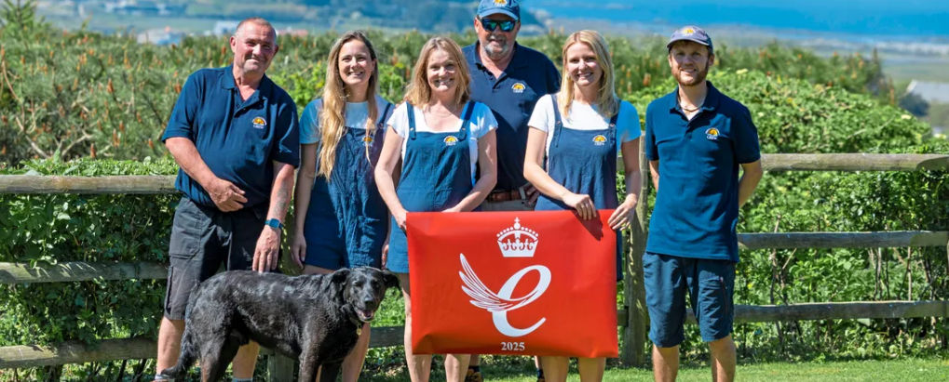
Our winners!
Notes:
That’s enough about the detail - Guernsey already has its first ever King’s Award recipient - so lets hear from them!

Slide 28
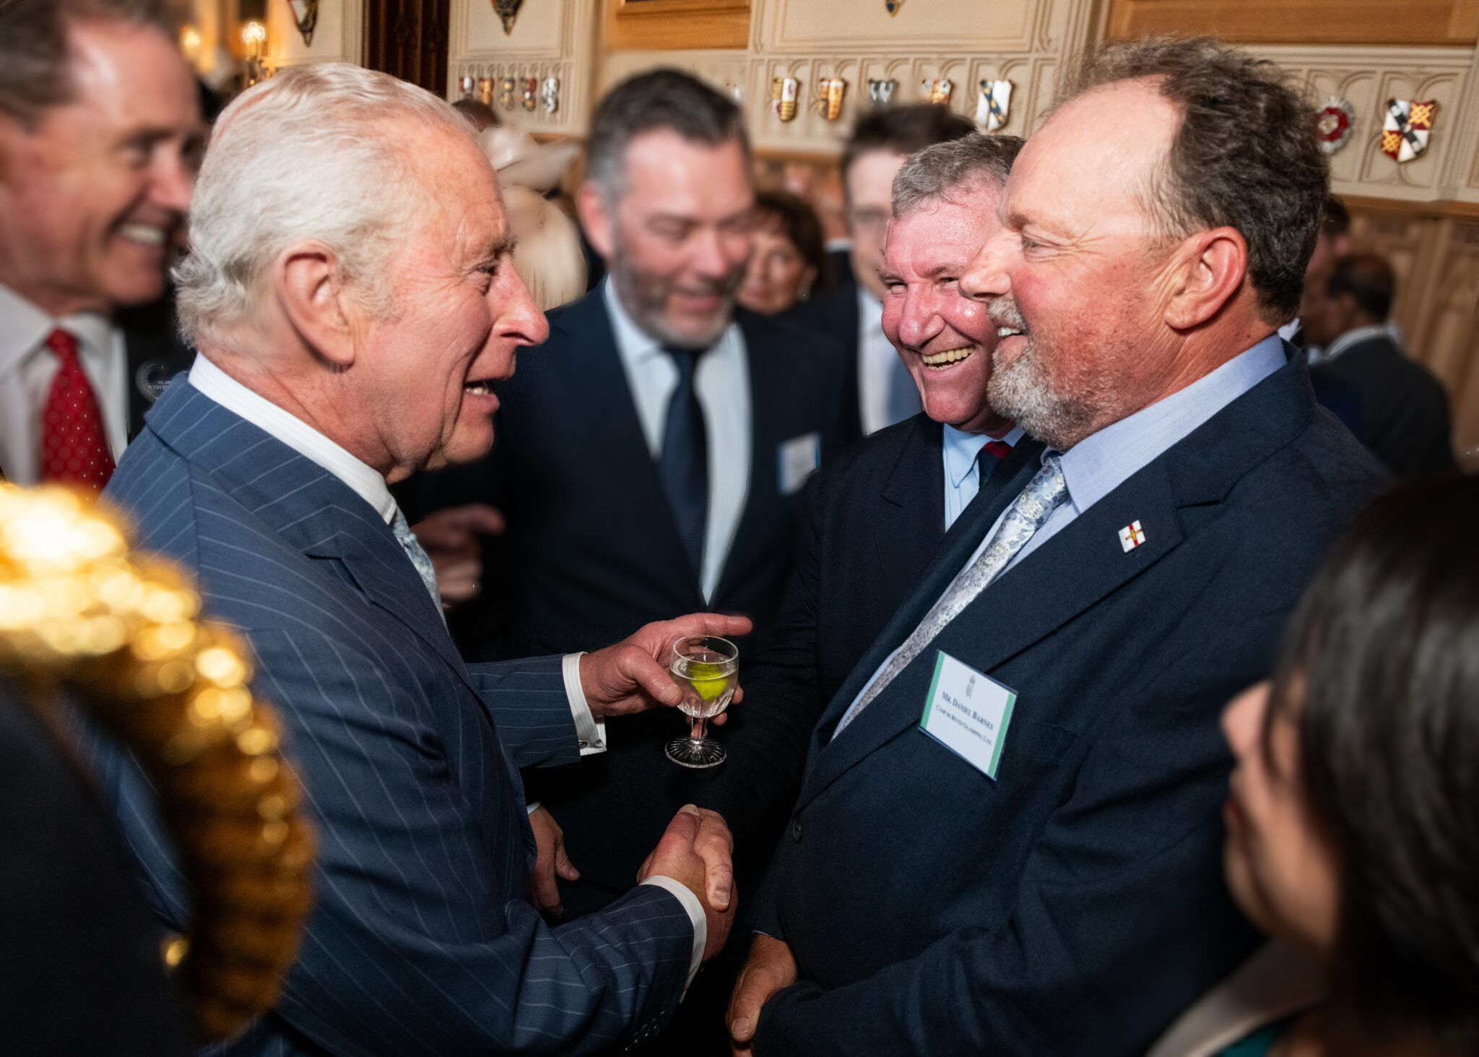
Camp de Reves
Reflect on Your Business
Be prepared to take a step back and look at every aspect of your business
The application is a great chance to evaluate your impact, values, and long-term goals
Read the Questions Carefully
Some questions may look similar at first
Avoid repeating yourself, each question is an opportunity to highlight something different in detail
Plan your answers before writing

Slide 29
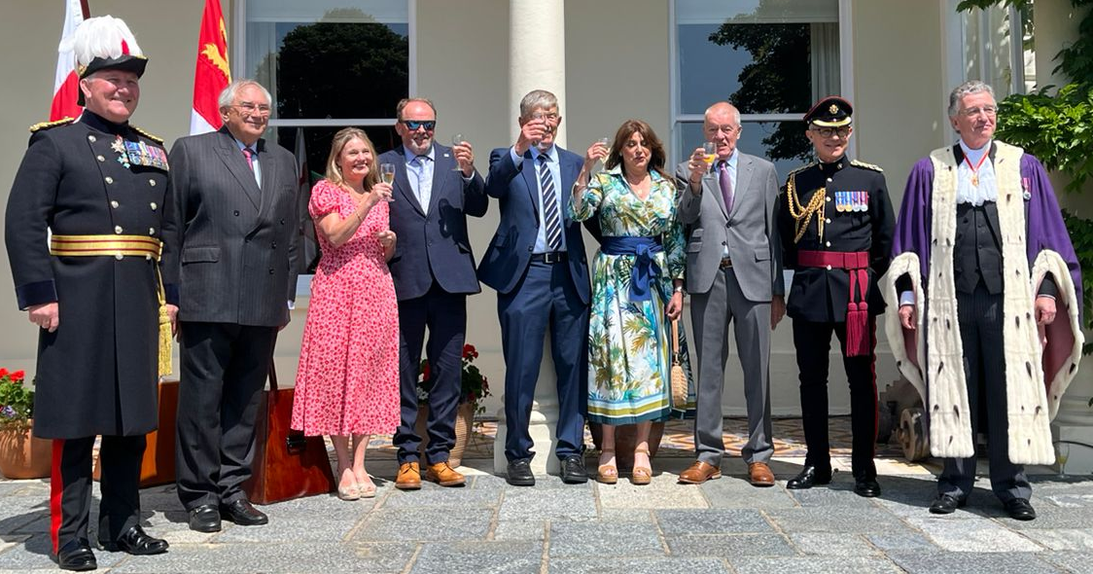

Back up everything with evidence
Back up your points with data wherever possible
Include key stats, testimonials, or measurable outcomes
Avoid fluffing points up to meet the word count
Good Luck
It’s a detailed process, but a rewarding one
The application process helps you appreciate your own journey and realise what areas of your business you need to focus on

Slide 30

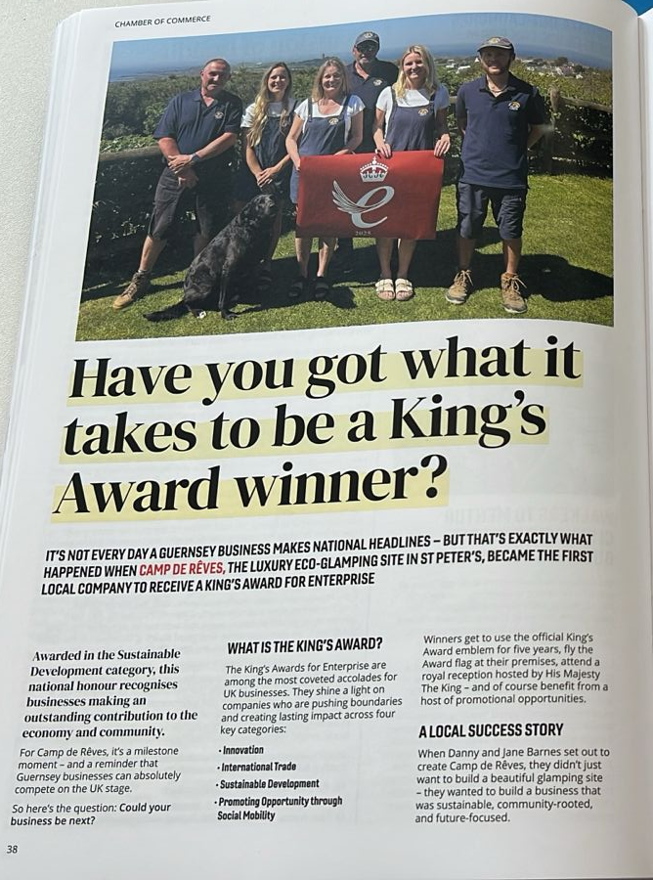
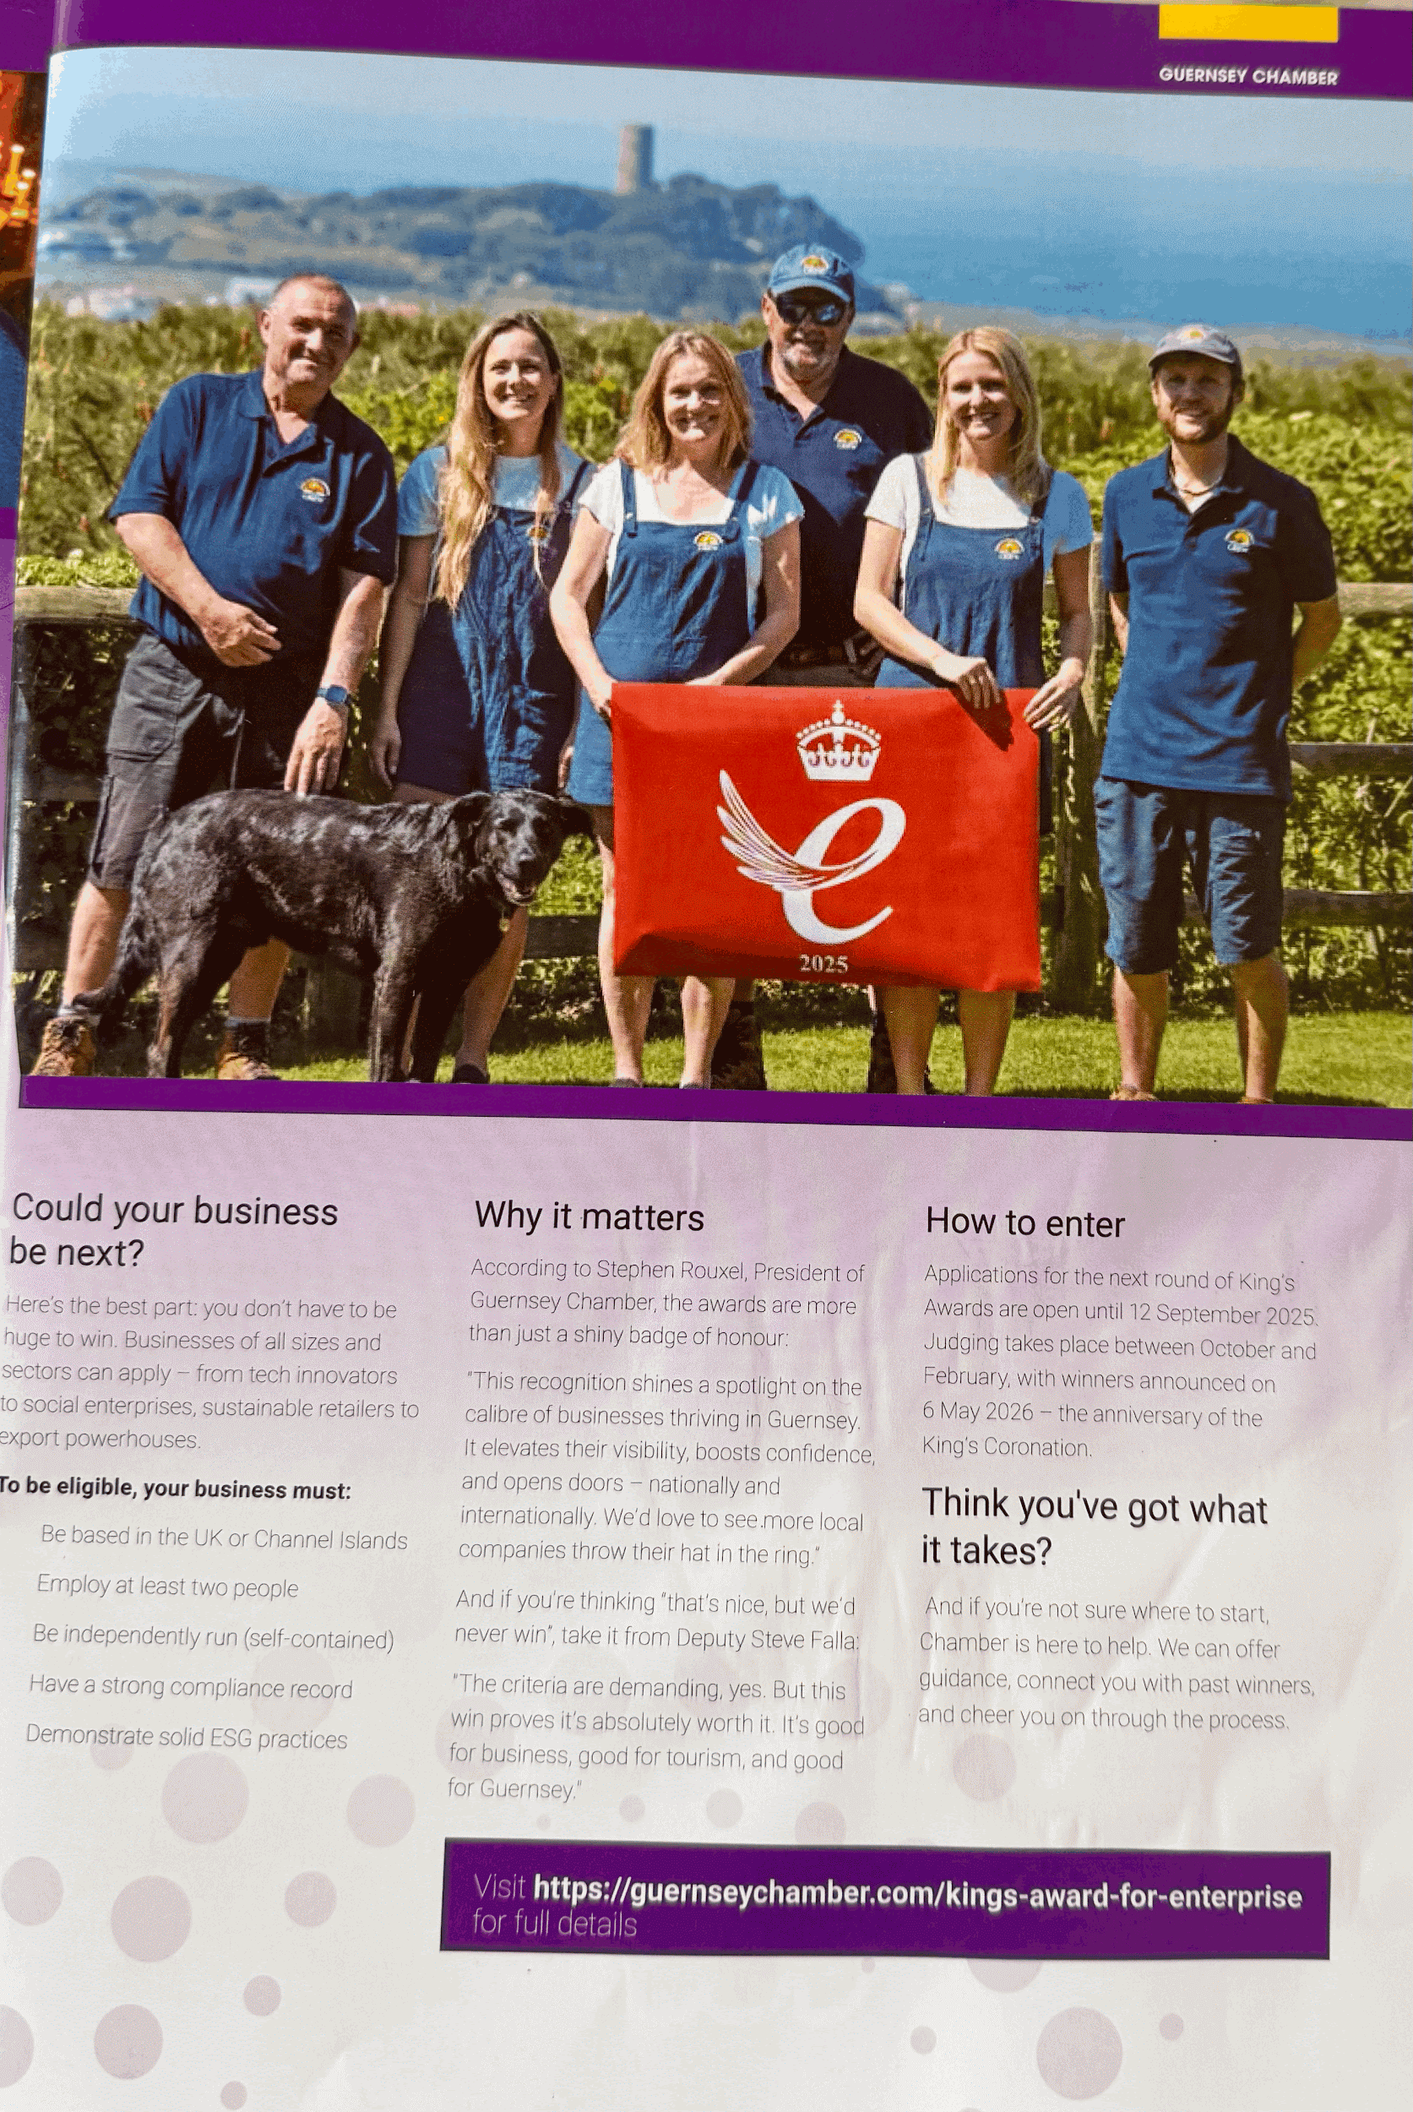
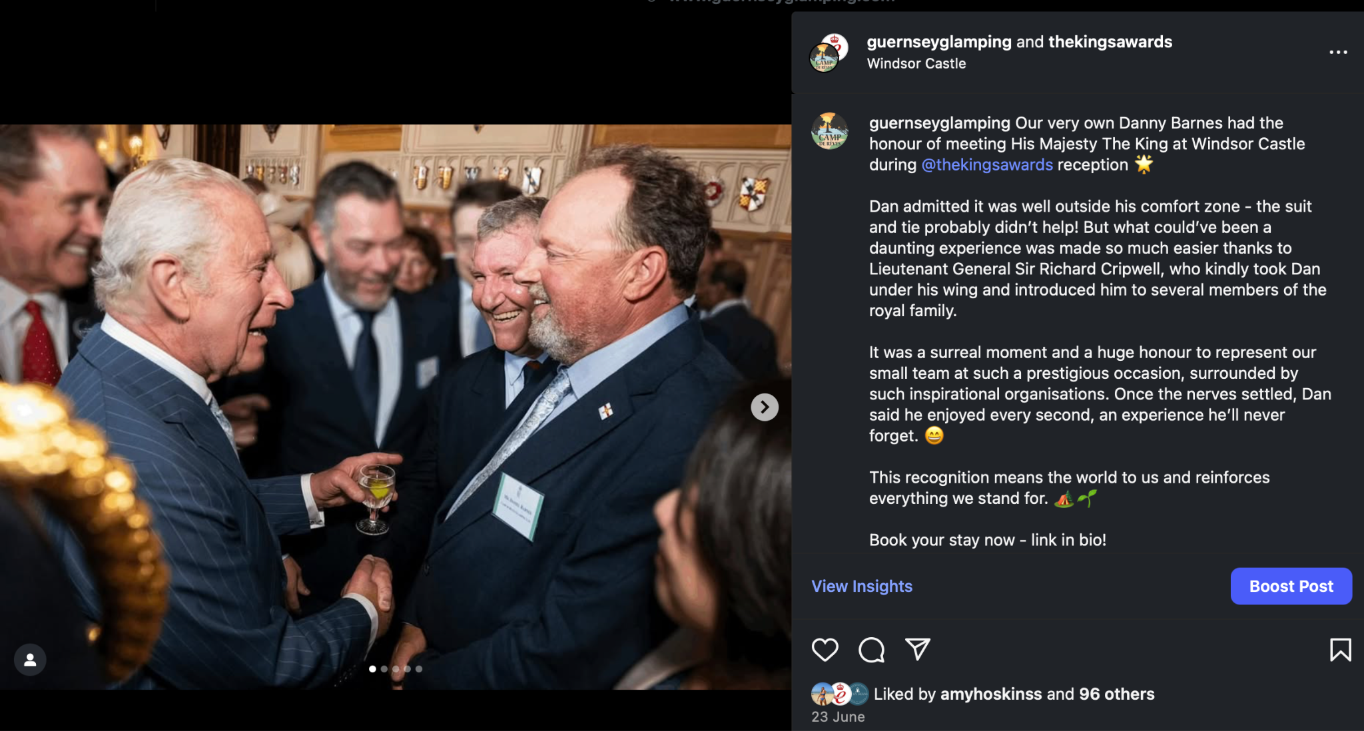
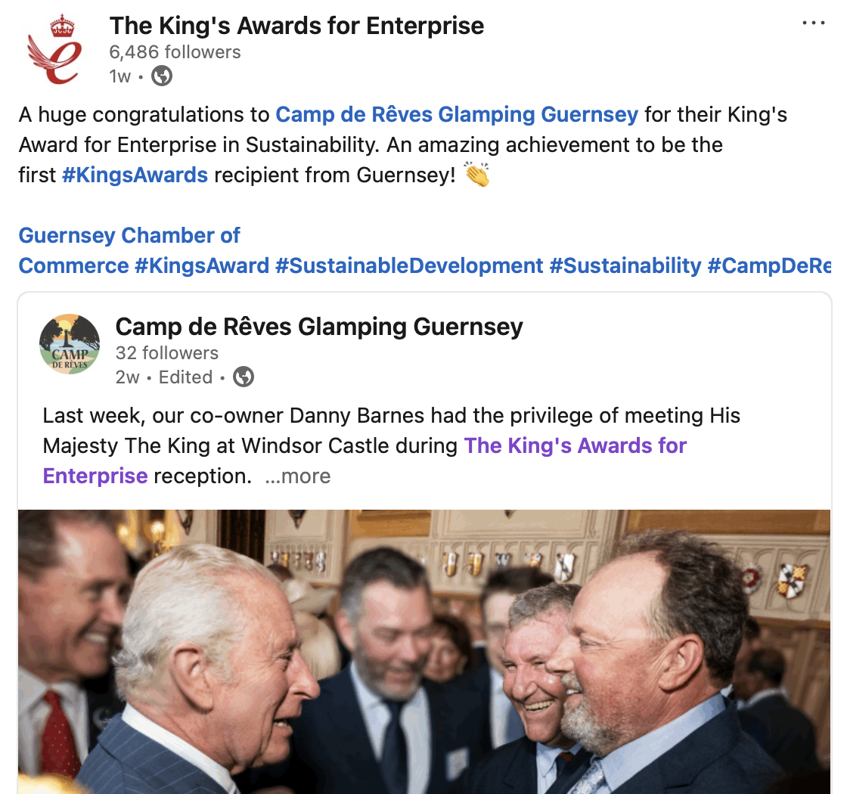
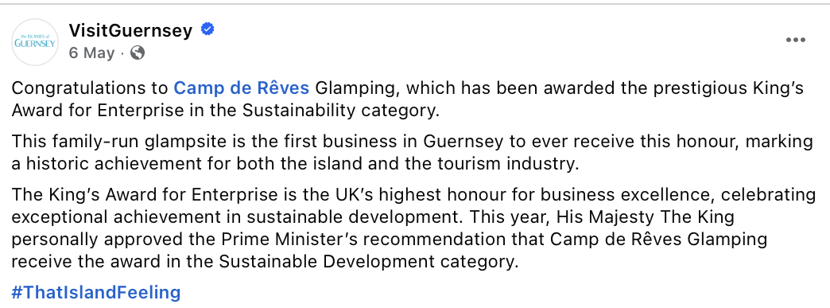
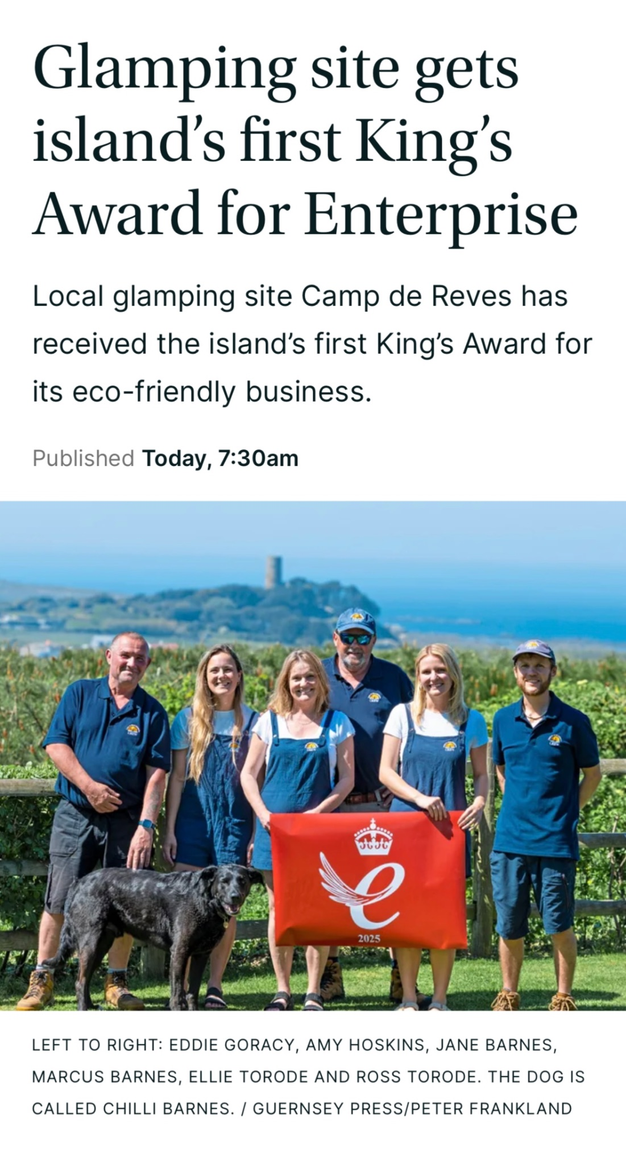
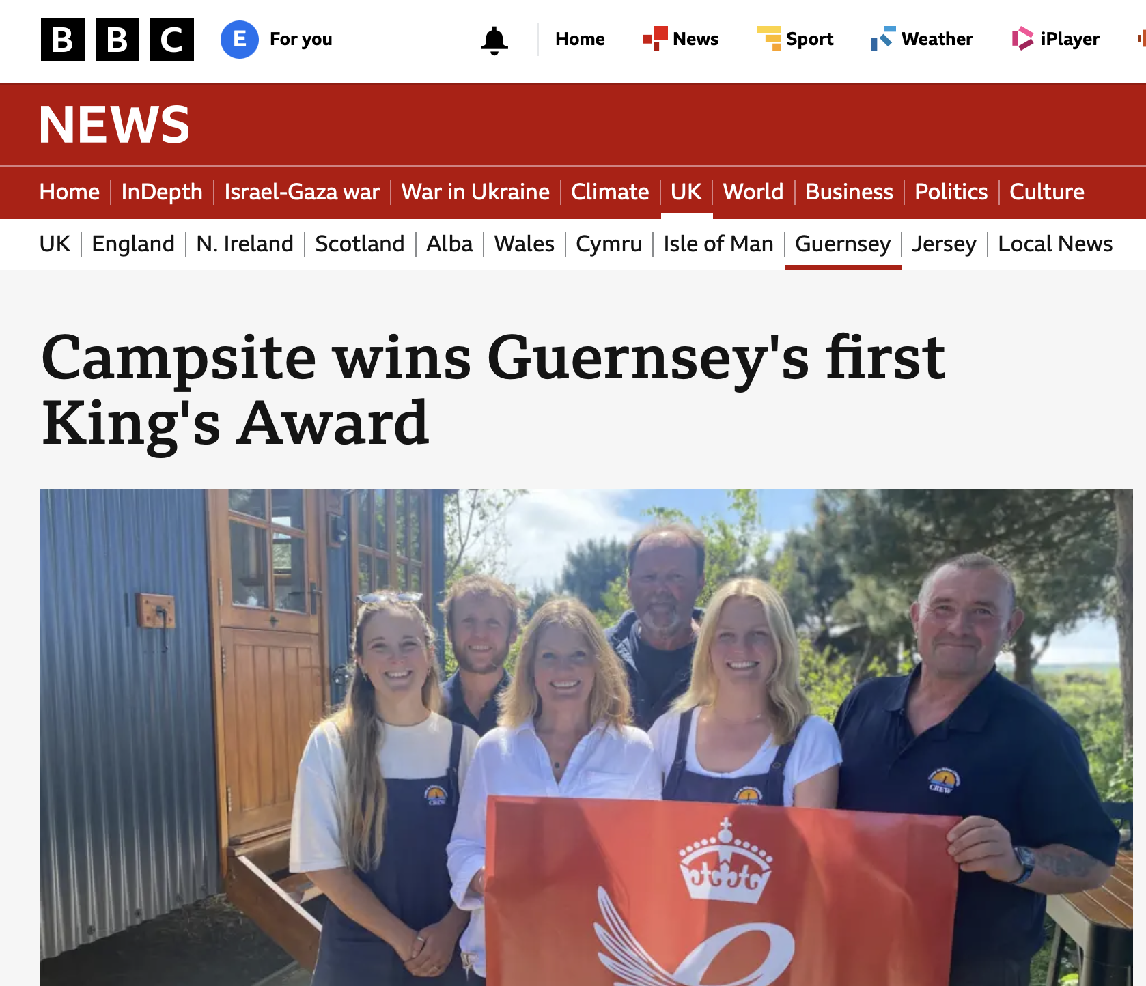
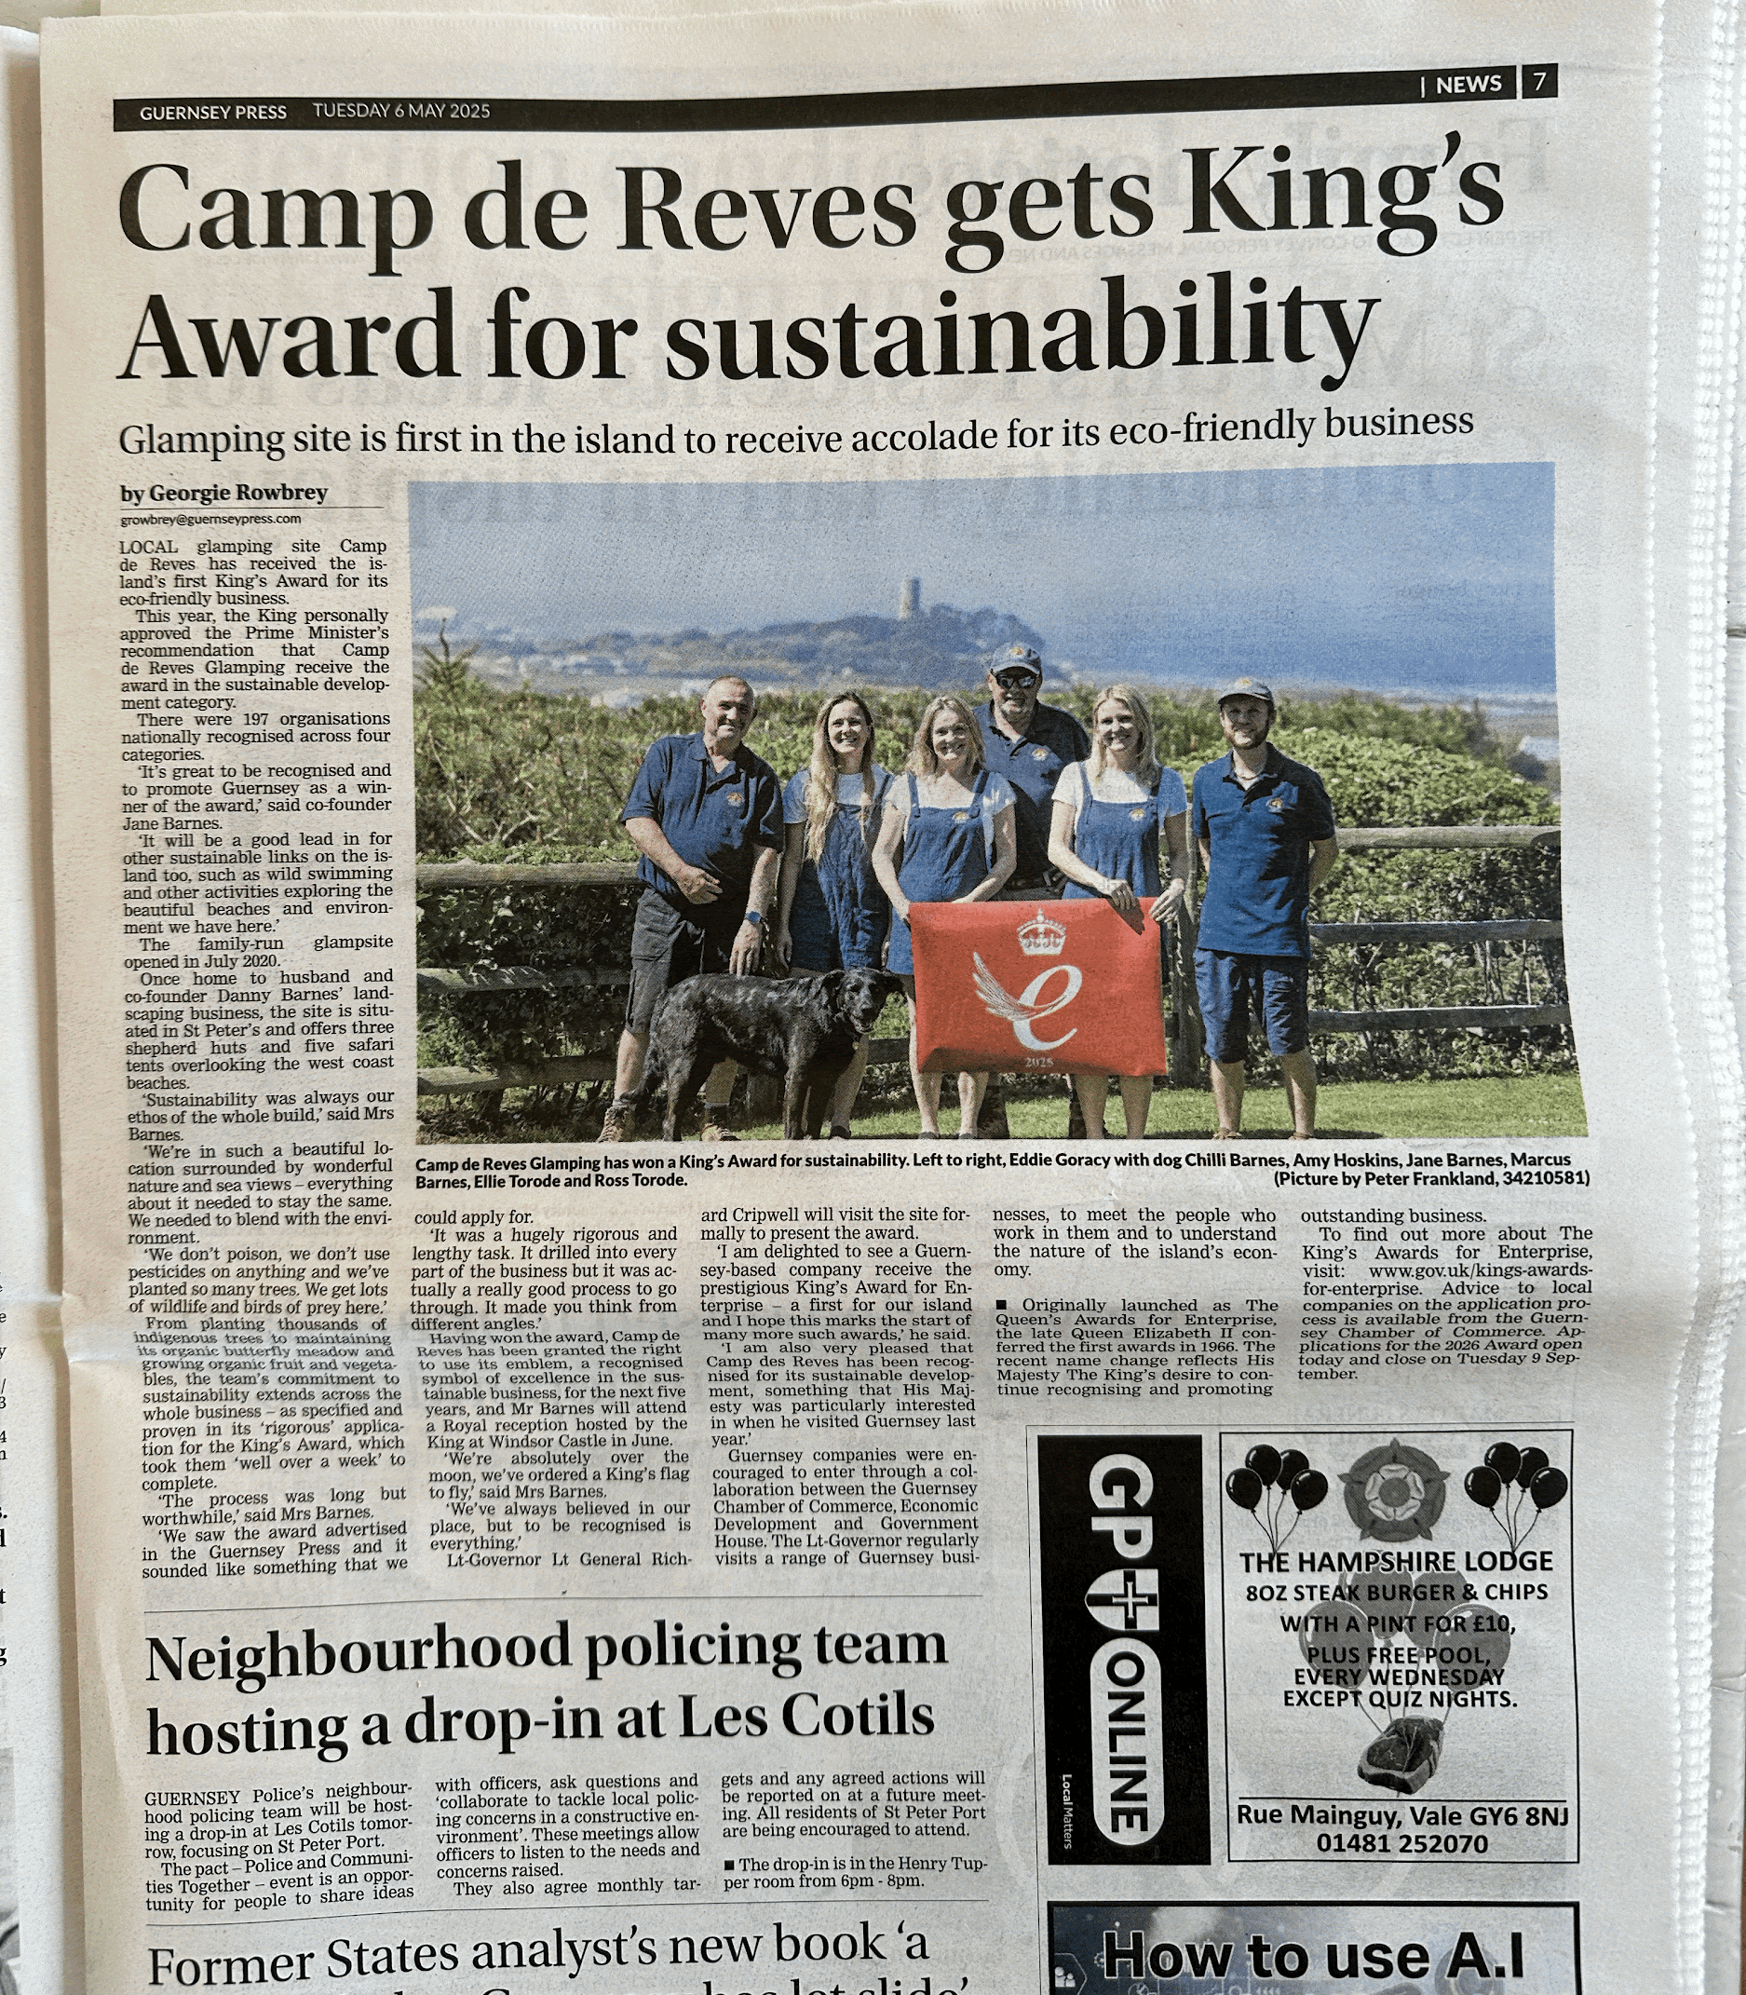
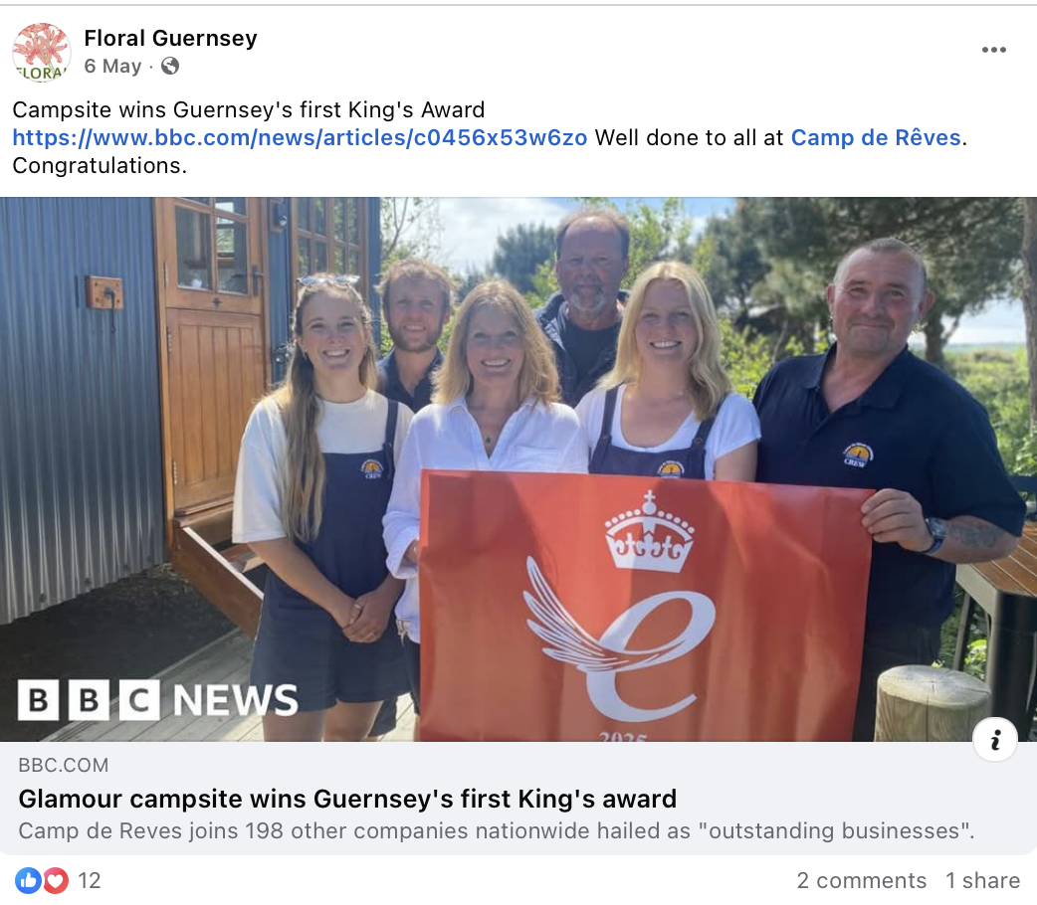
Media Coverage

Slide 31
Support
His Majesty’s Lieutenant-Governor
    Is The King’s personal representative and presents Awards on His behalf
    Contact details can be found via
    governmenthouse.gg/the-kings-award-for-enterprise
Guernsey Chamber of Commerce
hello@guernseychamber.com
guernseychamber.com
Kings Award Team
kingsawards@businessandtrade.gov.uk
www.gov.uk/kings-awards-for-enterprise

Slide 32

Contacting the KAE team
kingsawards@businessandtrade.gov.uk
020 4551 0081
www.gov.uk/kings-awards-for-enterprise
@TheKingsAwards
linkedin.com/company/the-kings-awards-for-enterprise

